Slide 1
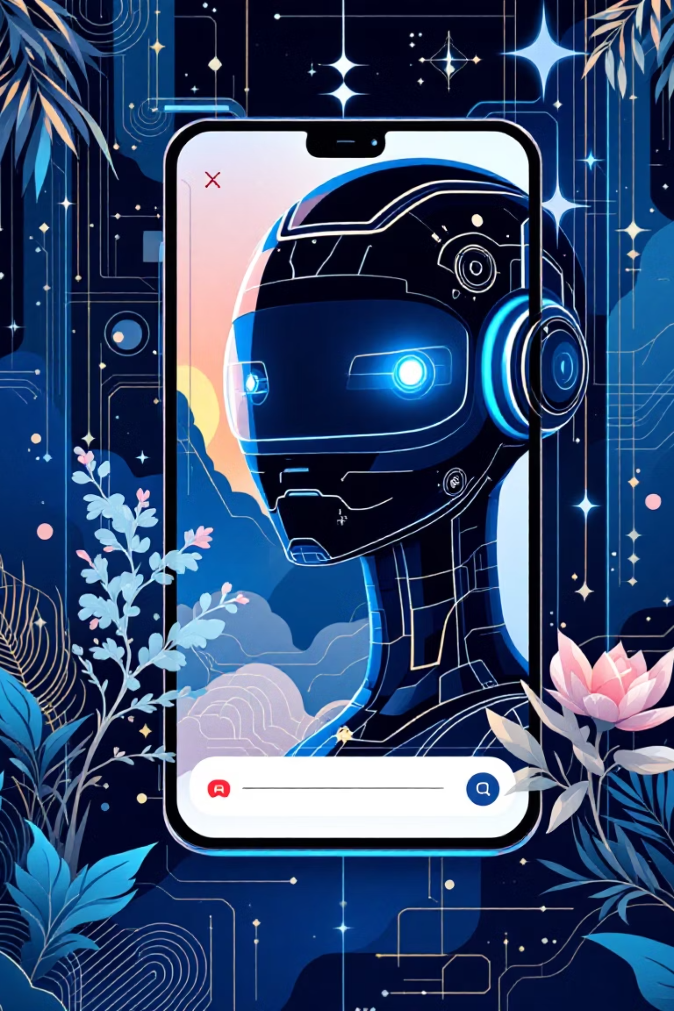


Python Project: Review 1 Overview
This presentation covers the initial scope and team structure for our foundational AI Chatbot project.

Slide 2



Objectives for Review 1:
Foundational Development
Develop a core AI chatbot capable of handling basic conversational exchanges.
Future API Integration
Lay the critical groundwork for future, seamless integration of advanced features, including external services like Google APIs.
Scalable Workflow
Establish a clear system design and a defined team workflow to ensure development is organized and scalable.

Slide 3
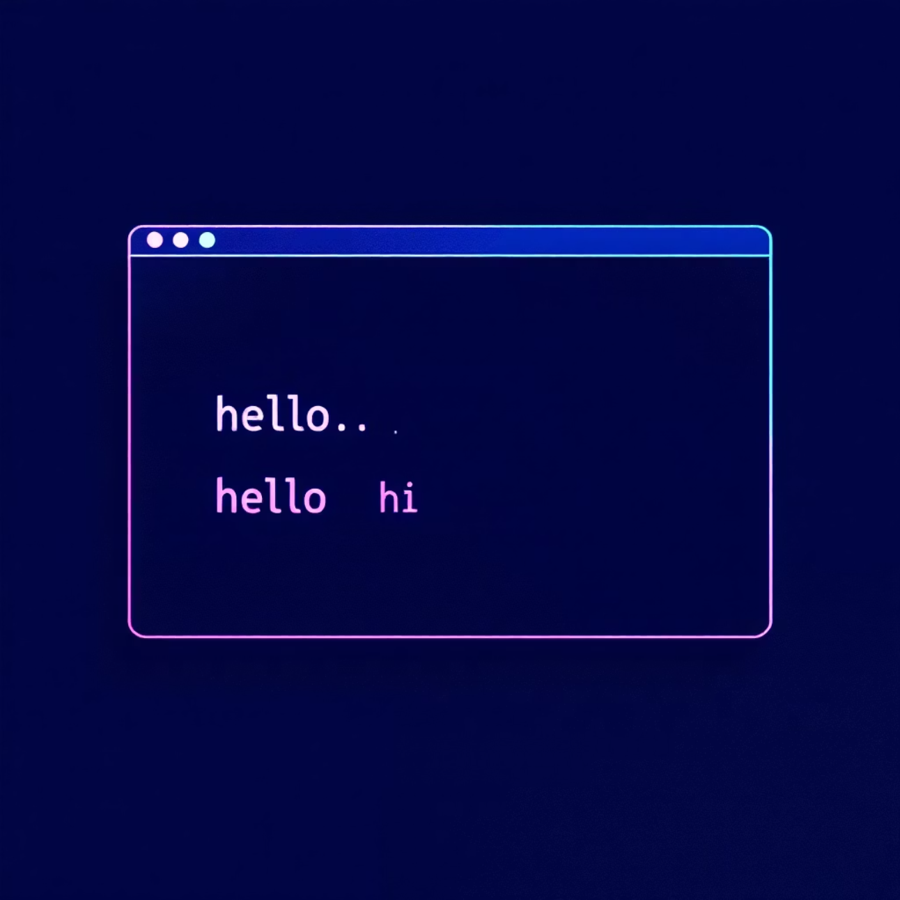
Key Features Implemented in Review 1
Basic Conversational Logic
Successfully demonstrated core interaction: the chatbot correctly replies with a greeting like “hi” when the user enters “hello.”
Testing and Debugging
Fixed early bugs related to message delivery and intent recognition.
User Interface Prototype
A functional prototype CLI was developed for basic text input and display of the chatbot's text output.

Slide 4




Tools & Technologies Used
We utilized familiar, robust tools to ensure rapid, stable development for this initial phase.
Python Language
Python Libraries
Used as the primary programming language for the core chatbot logic and functionality.
Reliance on basic string matching and OS related libraries to access the json file. Advanced NLP libraries are reserved for later stages.
Visual Studio Code
GitHub
Chosen as the integrated development environment for its robust features and efficiency.
Used for collaborative code management and team synchronization.

Slide 5

Expected Outcomes from Review 1
Functional Prototype
A working chatbot prototype capable of generating correct responses to a defined, limited set of user inputs.
Documentation
Comprehensive documentation detailing the initial system design, architectural choices, and the foundational codebase.
Foundation for Scaling
Established technical baseline ready for immediate iterative improvements and the integration of new features in the next sprint.

Slide 6

Problem Statement: Limitations of Conventional Chatbots
Rigid and Scripted Interactions
Customer Frustration
Users quickly become frustrated with robotic, non-adaptive responses that cannot deviate from predefined scripts, leading to low satisfaction scores.
Most existing chatbots offer extremely limited conversation options, often failing to effectively address the diverse and complex problems customers present.
Need for Flexibility
Our project aims to build a smarter, more flexible AI chatbot that can adapt its responses and ultimately improve the quality of user interaction.

Slide 7



Future Enhancements: Scaling Intelligence
Vocabulary Expansion
Significantly expand the chatbot's internal dictionary and improve its overall conversational capabilities.
Popular AI API Implementation
Implement popular AI APIs from leading technology firms like Google or OpenAI to enable enhanced context understanding and generate richer, more informative responses.
Interface Refinement
Develop a more interactive, intuitive, and user-friendly command line
interface.
Our long-term goal is to transition from rule-based logic to a machine learning foundation.

Slide 8





Project Team Structure & Responsibilities
Project Manager
Project Developer
Tester and Debugger
Oversees the overall project timeline, manages resources, and ensures all project deliverables are met on schedule.
Responsible for implementing the core chatbot logic, designing the foundational system architecture, and writing critical code.
Validates all chatbot responses, conducts rigorous testing, and documents any bugs or inconsistencies in performance.
Documentation Specialist
Maintains comprehensive project reports, prepares presentations, and keeps technical specifications up-to-date.

Slide 9
Project Team Structure & Responsibilities
Anuj Lamsal
Anish Dumre
Anuj Lamsal
Sanjan Raj Pant
Anish Dumre
Suryansh Sehrawat
Project Manager
Project Developer
Tester and Debugger
Sanjan Raj Pant
Suryansh Sehrawat
Documentation Specialist

Slide 10

Conclusion:
Review 1 marks a successful milestone, establishing a basic yet functional chatbot prototype with crucial core response capabilities.
Project Contributors:
25BCE2915, 25BCE2903, 25BCE2941, 25BBS0163

